Slide 1
Concurrency Control: Condition Variables
Dr. Muhammad Saeed

Slide 2
Condition Variables
Issues with Mutex Locks
Condition Variables
PThread Condition Variables API
Producer/Consumer problem
Need of synchronization
Summary

Slide 3
Example - Lock Issues

Slide 4
Issues with Mutex Locks
Locks provide basic synchronization (mutual exclusion) which does not work in all cases (as discussed in last slide)
Spin waiting wastes a lot of CPU cycles
What if a thread wanted to wait for a condition?
Solution
Condition variables

Slide 5
Condition Variables
Are provided by OS Kernel
Provide two operations
wait() – puts a thread in a queue of waiting threads
signal() – informs one or more waiting threads
If a thread wants to be informed of a change in state of a CV
it calls wait() on CV and it will be put in a queue associated with that CV
If a thread wants to inform other threads of a change it CV
it calls signal() on CV
The OS will awake one (or more) threads waiting in the queue associated with that CV

Slide 6
PThread Condition Variable API
pthread_cond_t c; // initialization
//wait function
pthread_cond_wait(pthread_cond_t *c,
pthread_mutex_t *m);
//signal function
pthread_cond_signal(pthread_cond_t *c);

Slide 7

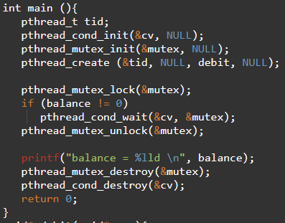
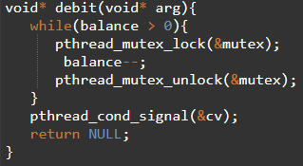
Example Code

Slide 8
Producer-Consumer
A classic synchronization problem
One (or more) Producer thread(s) put values in a buffer
One (or more) Consumer threads(s) consume values from the buffer
The buffer is bounded
How do we synchronize them?

Slide 9
Needs synchronization

Slide 10
Needs synchronization … contd.
Problems?
Notes:
1P, 2C. C0 runs and sleeps. P0 runs, produces, signals C0. C0 gets in ready state. Before C0 runs, C1 runs and consumes the value. C0 is after if() so will consume anyway!!

Slide 11
Example Run (c1,p,c2,c1)

Slide 12
Needs synchronization … contd.
Scenario
1 Producer
2 Consumers
C0 runs, sleeps.
P0 runs, produces, sleeps.
C1 runs, consumes, signals the CV.
Which thread is woken?
Notes:
1P, 2C. C0 runs, sleeps. P0 runs, produces, sleeps. C1 runs, consumes, signals the CV. Which thread is woken? If C0 is woken, then it will find buffer empty, sleep again and all will sleep for ever.

Slide 13
Example Run (c1,c2,p,c1,c2)

Slide 14
Use 2 CVs
Solution
Use 2 CVs

Slide 15
Multiple buffers

Slide 16
Covering conditions
Solution
Broadcast signal

Slide 17
Summary
We have seen a new synchronization primitive called a condition variable
Unlike locks, condition variable does not spin wait, instead, it provides two function wait and signal
wait() call puts the calling thread in a wait queue associated with the condition variable
signal() call awakes one or more waiting thread in the condition variable waiting queue
Condition variables enable us to neatly solve producer/consumer problem, as well as covering conditions.

